Slide 1


Slide 2

Team Member Details
Team Name | SOUL
Team Members >> | 1 (Leader) | 2 | 3 | 4
Name | Smit Mhatre | Omkar Pashte | Dhruv Patil | Suyash Palkar
Institute Name | VCET | VCET | VCET | VCET
Email | smit.222123101@vcet.edu.in | omkar.222323105@vcet.edu.in | dhruv.222373105@vcet.edu.in | suyash.222243105@vcet.edu.in

Slide 3

Problem Statement
This project uses machine learning, IoT sensors, and drones to manage crowd congestion at large events. The system analyzes CCTV footage to detect crowd surges, deploys drones for better surveillance, and gathers data from IoT sensors. In case of congestion, it pinpoints problem areas for quick intervention and sends automated announcements to calm the crowd, ensuring better safety and preventing stampedes.
.

Slide 4

IDEA/APPROACH
Crowd Monitoring with CCTV & Machine Learning.
Drone Deployment for Aerial Surveillance
IoT Sensors for Environmental Data
Proactive Response
Automated Announcements
Congestion Detection & Localization

Slide 5

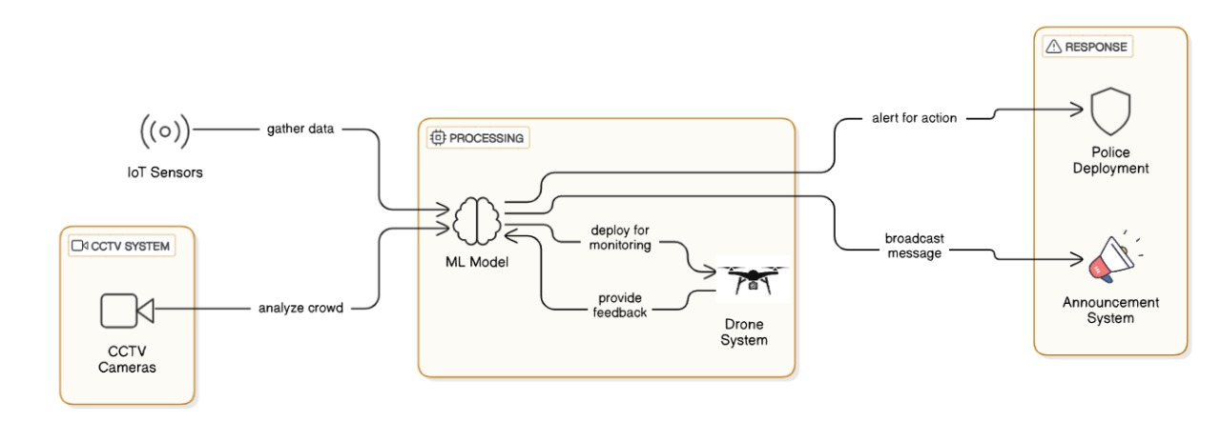
SYSTEM ARCHITECTURE

Slide 6

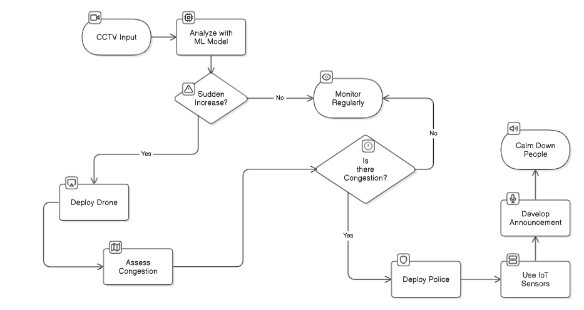
FLOWCHART

Slide 7

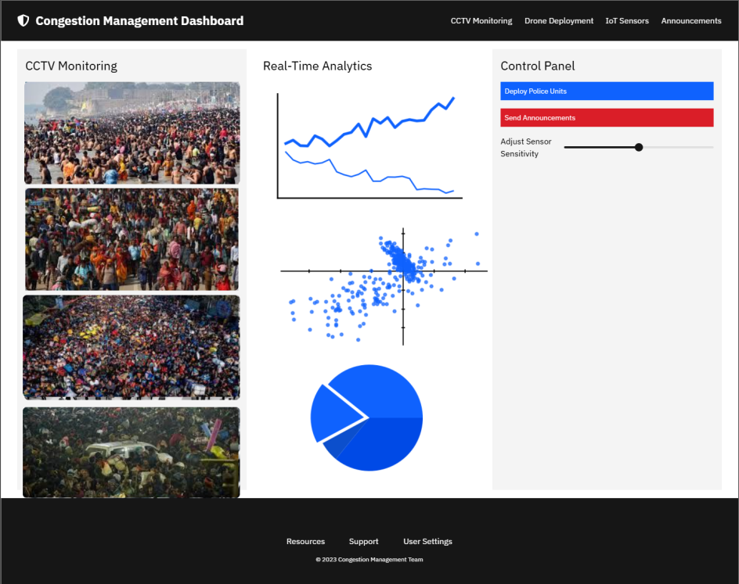
PROJECT PREVIEW

Slide 8
















TOOLS / TECHNOLOGY
FRONT-END
BACK-END
MACHINE LEARNING

Slide 9

